Slide 1
“BusIT.com – An Online Bus Scheduling and Ticket Booking System”
Project Presentation
on
Submitted by :
Arun Kumar M –BC182408
Mahanthesh -182436
[BCA – IV Sem 20-2021]
Internal Guided By: Rohini Mugur
Department of Computer Application
[MIT First Grade College, Mysore – 2021]

Slide 2
Introduction
Travel industry is evolving day to day. As the industry evolves, the need to digitalize all the transactions becomes need of the hour.
A Software which provides an instant Solution for Bus Enquires, Ticket Booking and Cancelation of Tickets for a Customer is much Helpful.
Similarly, a Dealer needs a software to manage and maintain all the data of bus details, user’s details, reservation details in one place.
This project helps to manage Bus scheduling for a Bus Dealer and provides an platform to maintain all the data. Tickets can be booked by a Customer and cancelled before departure. This software can be used to search bus routes from specific location to its destination and book them online.

Slide 3
Project Profile – BusIT.com
Project Title :- | BusIT.com – Online Bus Scheduling and Ticket Booking System
Project Objective :- | Dealer :- Add, Remove and Update Bus Details, manage Customer’s Information. Customer :- Search bus, Select Bus, Book and Cancel Tickets .
Front End Tool :- | Html, CSS and JavaScript.
Back End Tool :- | PHP
Database Used :- | MySQL. [ Xampp ]
Type Of Application :- | Web Application.

Slide 4
Existing System
All the Booking process was done manually and offline.
As it was an Offline process, the Customer had to Walk-in to the Bus agency to get all the information regarding available Buses, Bus Time, Available Seats and the Cost.
Cancelation of the Tickets was not available.
Bookings on Weekends and after office hours was Difficult.

Slide 5
Need For New System
A New System could be helpful for both Bus Dealer and Customer.
A new System will be Time saving and more Profiting.
A new System will provide all the information needed by the customer like Bus Details, Bus Time, Bus Date, Ticket Cost, and availability of Tickets in one place.
A new System will provide the Customer, an opportunity to cancel the Tickets before the Bus departure.
Login and Password service for Bus Dealers and Customers.

Slide 6
Minimum Hardware Requirement
Client Side Requirement :
Processor : | 1.5GHz
RAM : | 512 MB
Hard-Disk : | 80 GB
Server Side Requirement :
Processor : | 2.5GHz
RAM : | 1 GB
Hard-Disk : | 80 GB

Slide 7
Minimum Software Requirement
Client Side Requirement :
Operating System : | Windows 2007/XP or equivalent OS.
Web Browser : | Internet Explorer 6.0 or any compatible Browser.
Server Side Requirement :
Front-End : | PHP 5.3.0
Back-End : | MYSQL 5.1.36
Web Server : | WAMP 3.1

Slide 8

System Flow Chart
START
View Website
VISITOR
no
Registration
If Registered ?
Yes
Login
no
Valid UserId &
Password
Yes
no
Is Admin ?
ADMIN
User
Yes
A
B
C

Slide 9
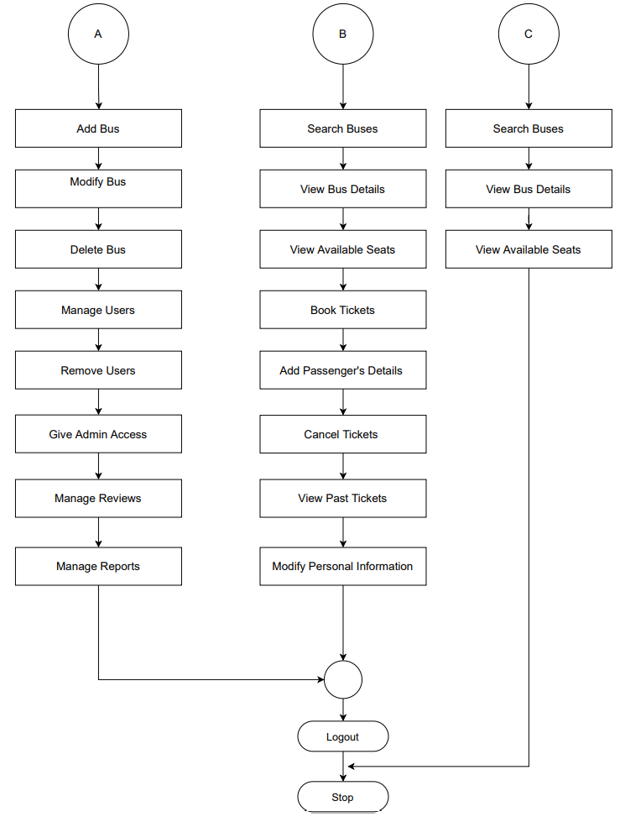

Slide 10
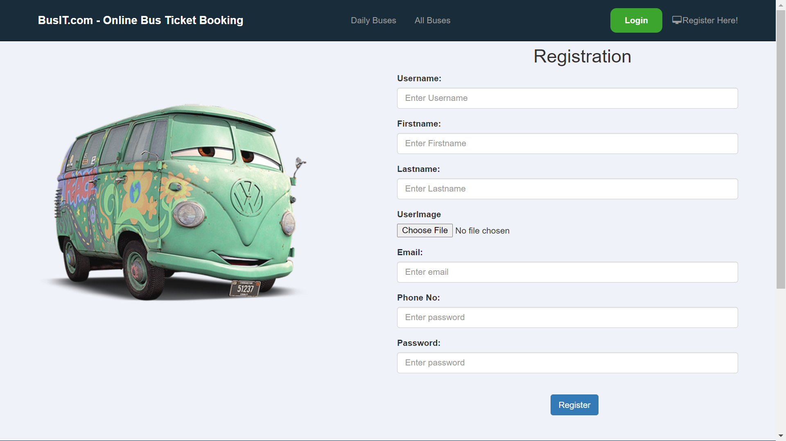
Module Specifications:
Registration Module :
The user has to go through the registration process first, in order to book Tickets on BusIT.com Website.
The user has to provide his First name and Last name, a valid Email address, a 10 digit phone number to set Username and Password.

Slide 11
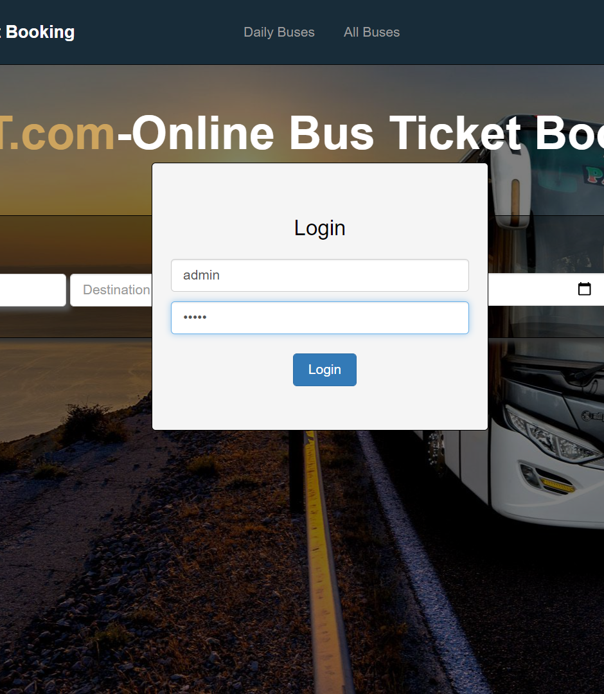
Login Module :
Login module includes credentials like Username and Password to detect the registered User and their role in the website.
If the given credentials match the role of “admin", access to the "Admin Panel" is granted to the particular User.

Slide 12
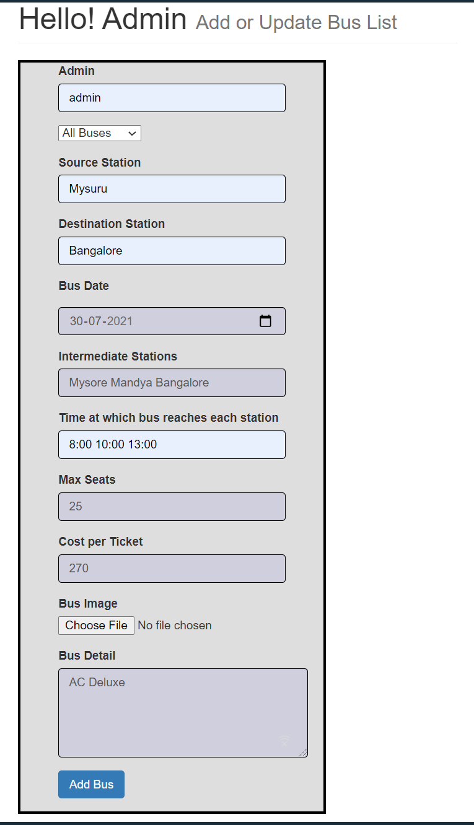
Add Bus [admin] Module :
Admin can Add or Modify Bus details by adding following entities :-
Source and Destination of Bus.
Bus Date and Time.
Stations Covered.
Maximum no of Seats
Bus Image
Cost of Tickets.
And detailed Description of the Bus.

Slide 13
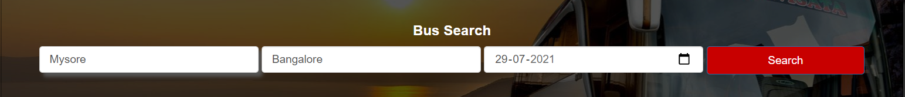
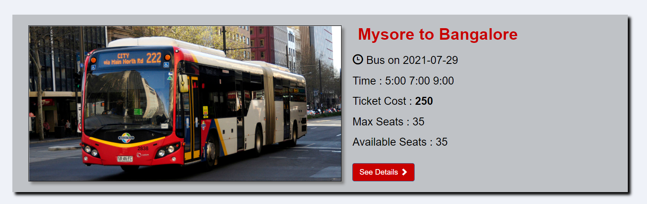
Search Bus Feature :
Users can search Buses by Entering the Source Place, Destination Place and Date of Departure.

Slide 14
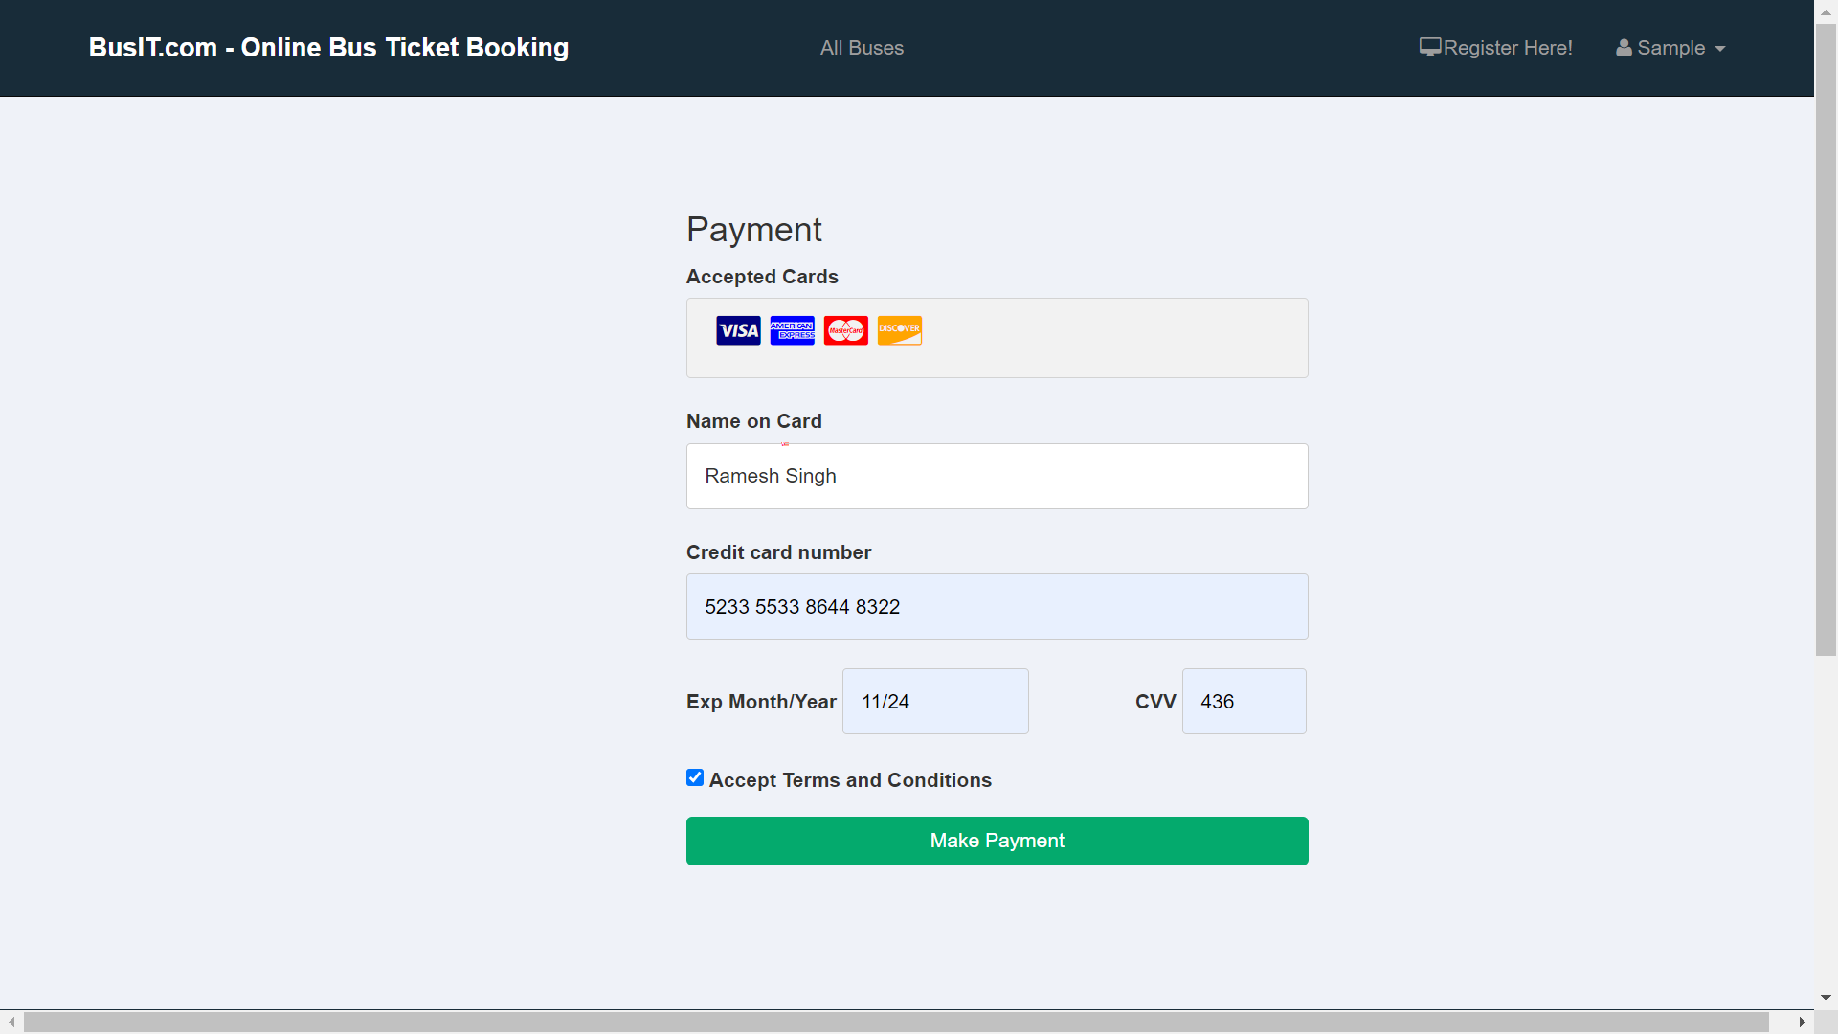
Payment Module :
Customer gets directed to Payment Page on Successful Ticket Booking.
Customer has to make a Payment to Confirm his/her Booking.
Customer can enter his/her Card Details to make Successful Payment.

Slide 15
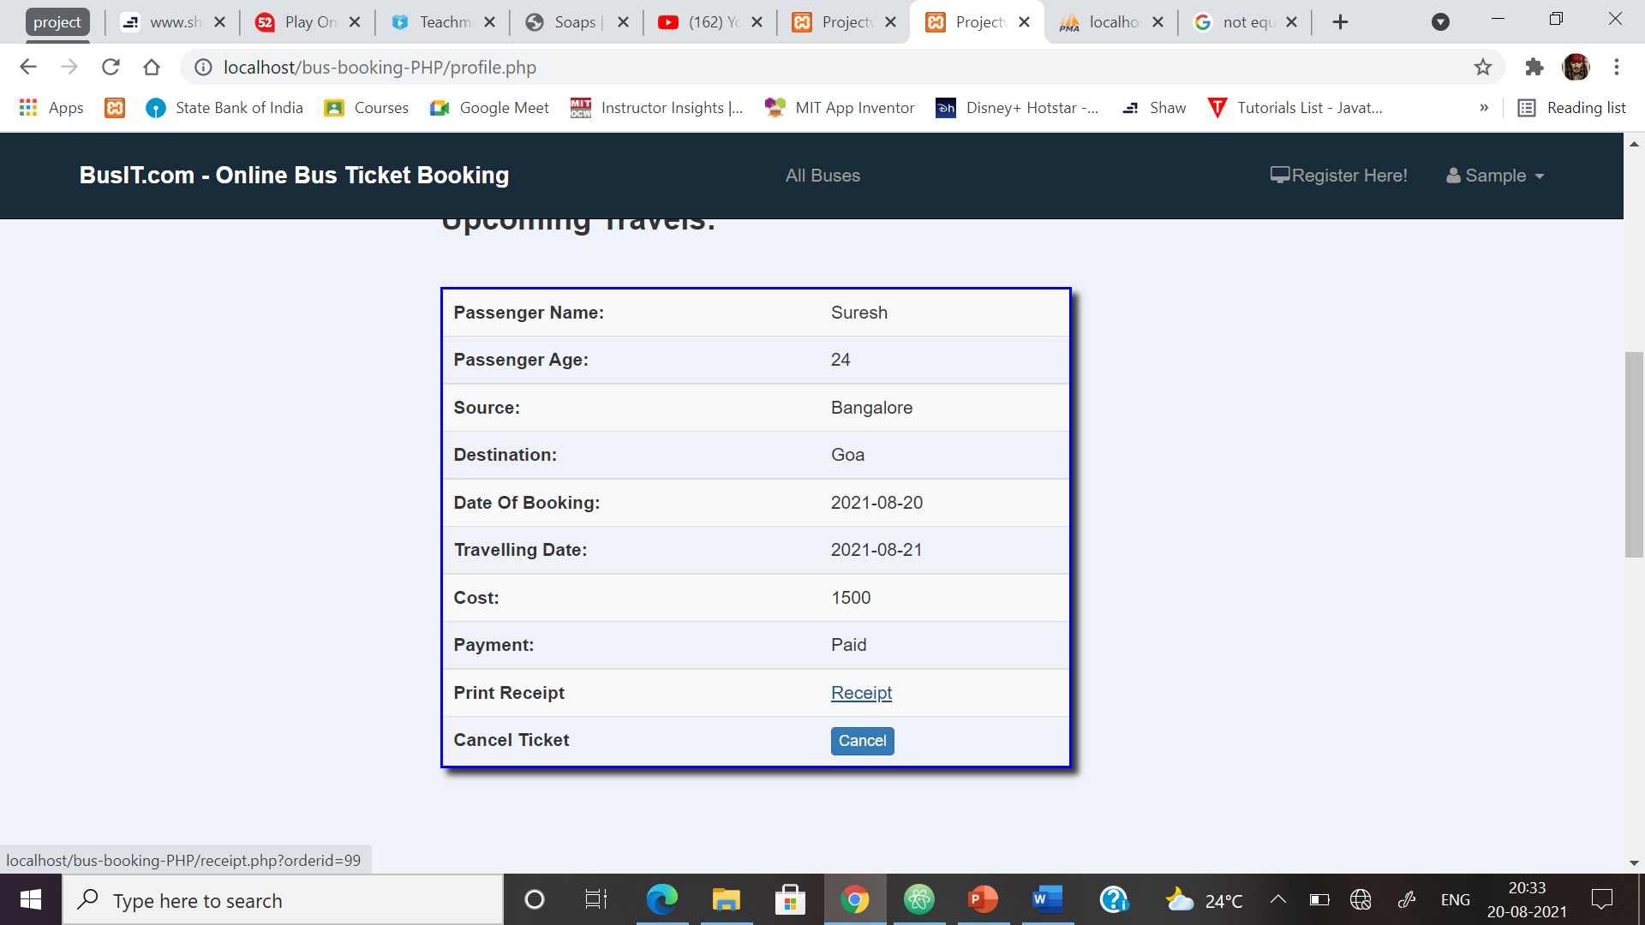
Ticket Cancelation Module :
Passenger can Cancel his/her Ticket
before Bus Departure.

Slide 16
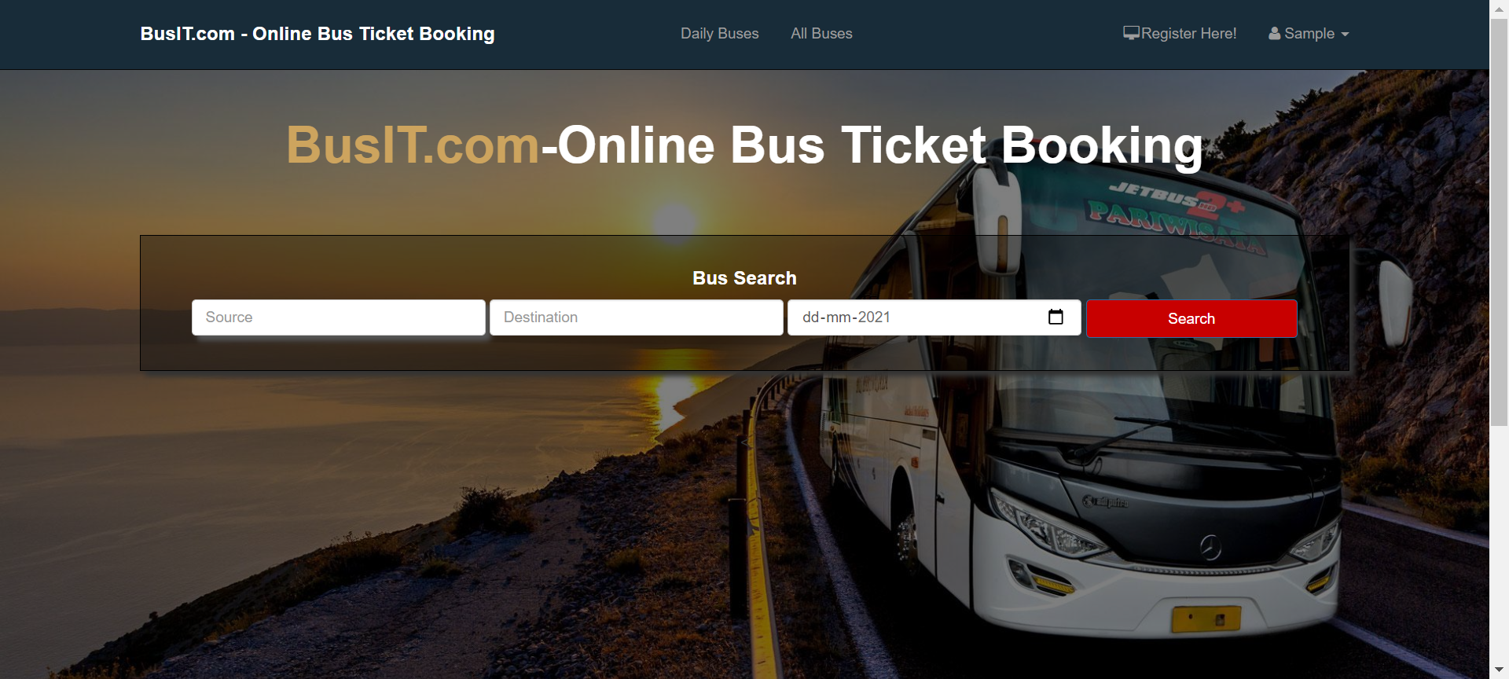
Input/Output Design :
Home Page

Slide 17
Registration Page

Slide 18
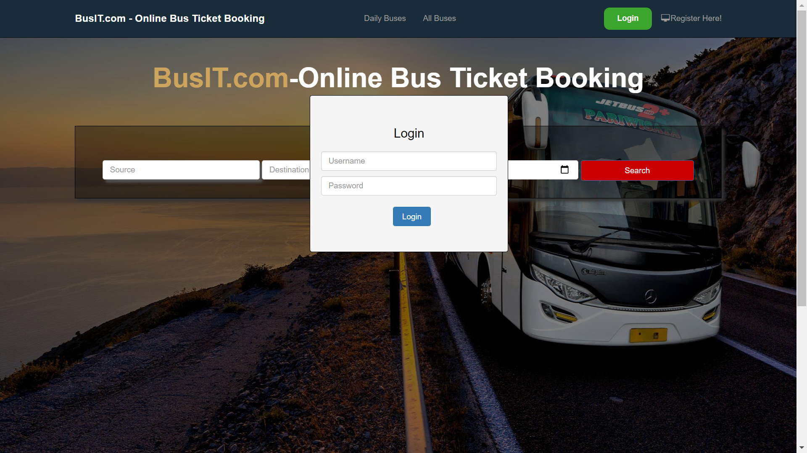
Login Page

Slide 19
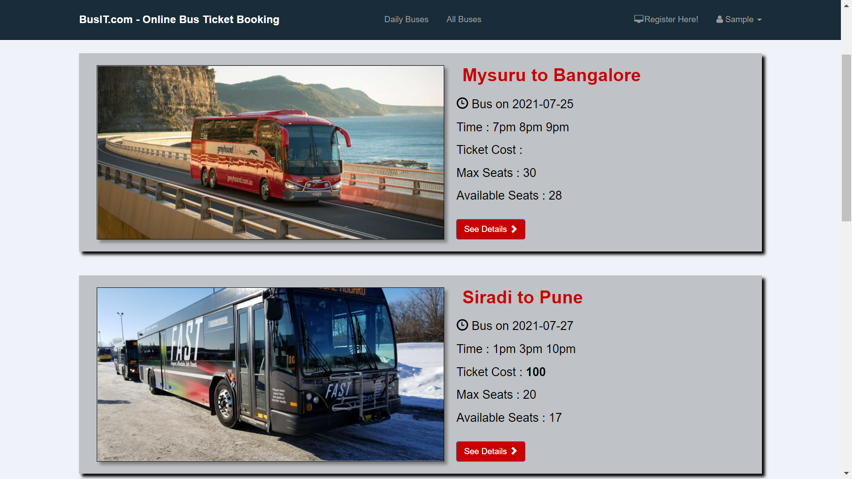
User Bus List Page

Slide 20
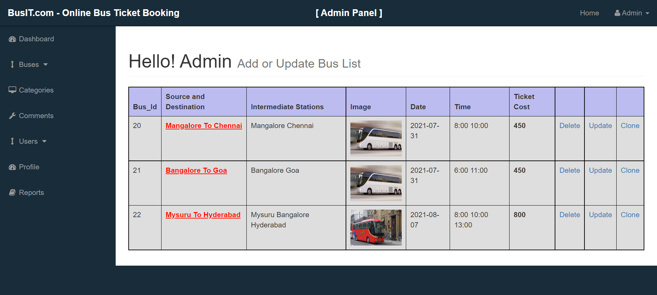
Admin Bus List Page

Slide 21
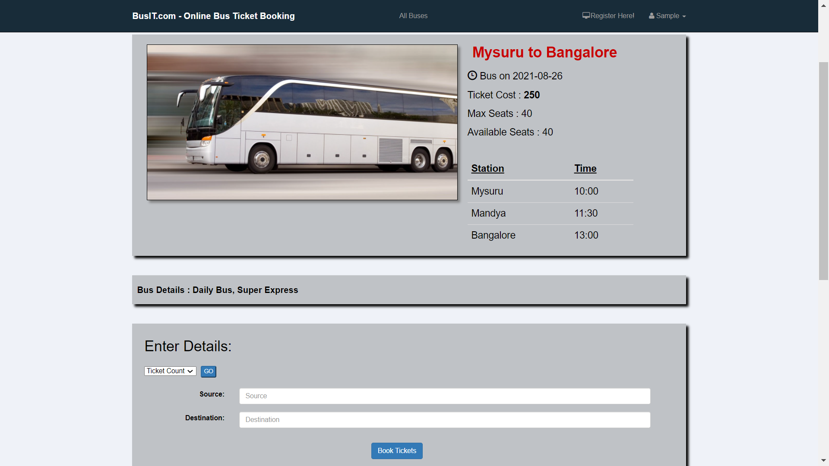
Bus Info and Ticket Booking Page

Slide 22
Payment Page

Slide 23
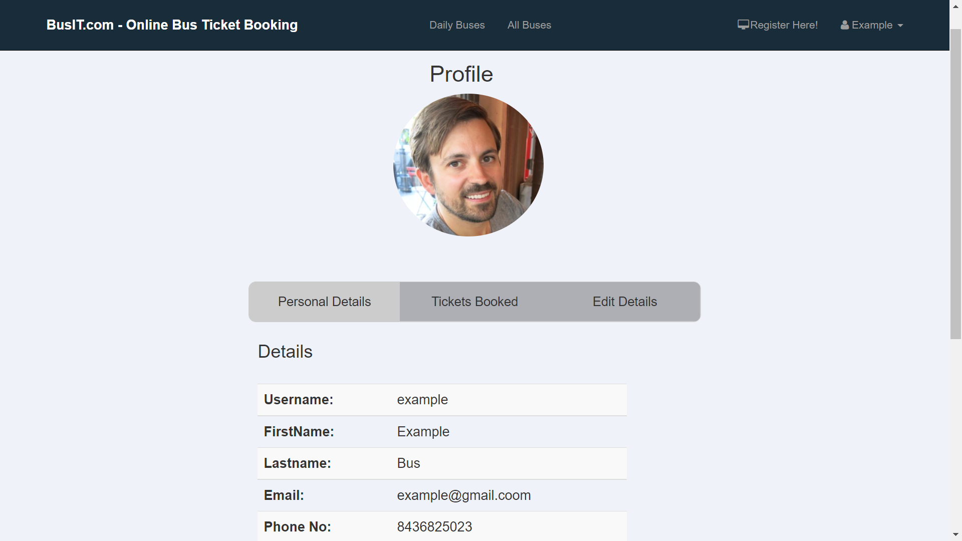
Profile Page

Slide 24
Ticket Info and Cancellation Page

Slide 25
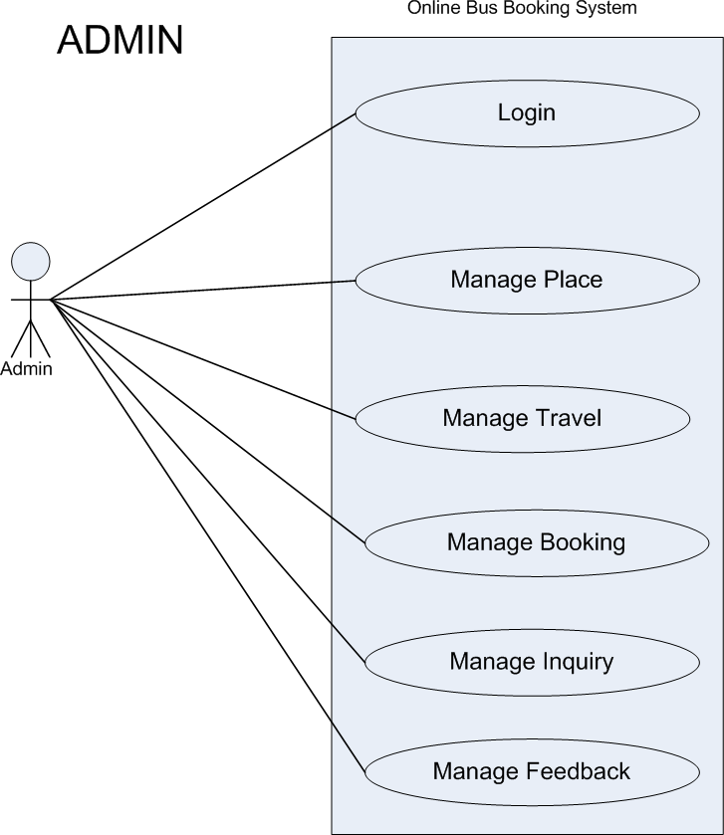
Use-Case Diagram for Admin
Admin Can:-
Can Add Buses, City and Time,
and other Details.
Can View Bus List.
Can manage Reports.
Can manage Feedback.
Can manage Users.

Slide 26
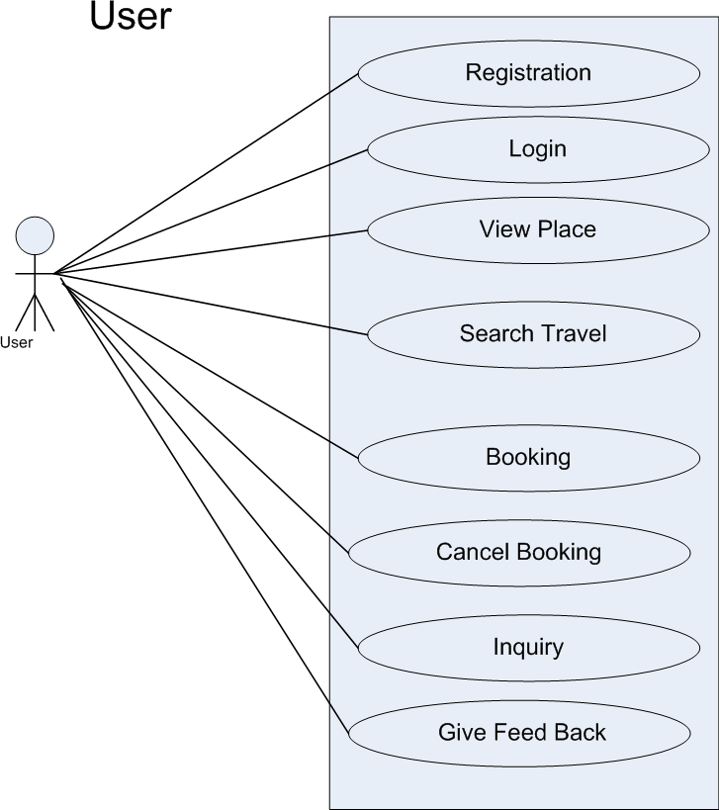
Use-Case Diagram for User
User Can:-
Can Search Buses, City and Time.
Can View Bus details.
Can Book Tickets.
Can make an Enquiry.
Can Cancel Tickets.
Can Give Feedback.

Slide 27
Thank You!

